Slide 1


SMART INDIA HACKATHON 2026
Problem Statement ID –SIH26192
Problem Statement Title - Flash Flood Prediction System for Hilly Regions using Multi-Source Data Theme
Theme- Disaster Management
PS Category- Software
Team ID- SIH 452
Team Name - <helloSIH>

Slide 2
JAL DRISHTI
<helloSIH>
Problem
Hilly regions face flash floods/landslides with very short warning times
Current systems lack hyper-local prediction and fail during monsoon (cloud-blocked satellites, dead telecom towers)
Warnings, even when issued, often don't reach or aren't understood by villagers in time to evacuate
Solution
SAR-Based Flood & Soil Monitoring : Use Sentinel-1 SAR (Synthetic Aperture Radar) instead — it's an active radar sensor that penetrates cloud cover and works day/night.
lead time for Upstream Watch + Time-to-Reach Prediction: Instead of a flat "flood risk: high," compute two concrete numbers per village: distance-to-impact and time-to-impact.
Auto-Generated Evacuation Route with Live Hazard Overlay : A Google-Maps-style live rerouting system for evacuation, not just a static "evacuate" instruction.
Auto-generated local-language voice alert
LoRa (Long Range radio) modules at village level form a mesh network : Telecom towers are typically the first infrastructure to fail in a hilly flood disaster
ShelterBnB: Community-Led Evacuation Hosting : an 'Airbnb for emergencies'—we remove these emotional barriers and provide a psychologically safe, dignified temporary home
Key Features
SAR (Sentinel-1) based flood/soil detection — works through monsoon cloud cover
Upstream Watch — distance & time-to-impact countdown per village (e.g. "ETA 3h 20m")
Offline LoRa mesh alert relay — works even when cell towers go down
Auto local-language voice alerts (Assamese, Nepali, etc.)
Live-rerouted evacuation paths (Google Maps-style, hazard-aware)
Kirana Guard — decentralized micro-relief supply via local Kirana stores
ShelterBnB — community-hosted evacuee shelter matching
Novelty
Cross-border (Nepal DHM) upstream data — most teams stay India-only
Radar over optical satellite — solves the "clouds block satellites during floods" blind spot
Physically grounded lead-time model (Muskingum-Cunge routing), not a guessed ETA
Goes beyond prediction — solves last-mile delivery, evacuation, supply & shelter, not just alerting

Slide 3
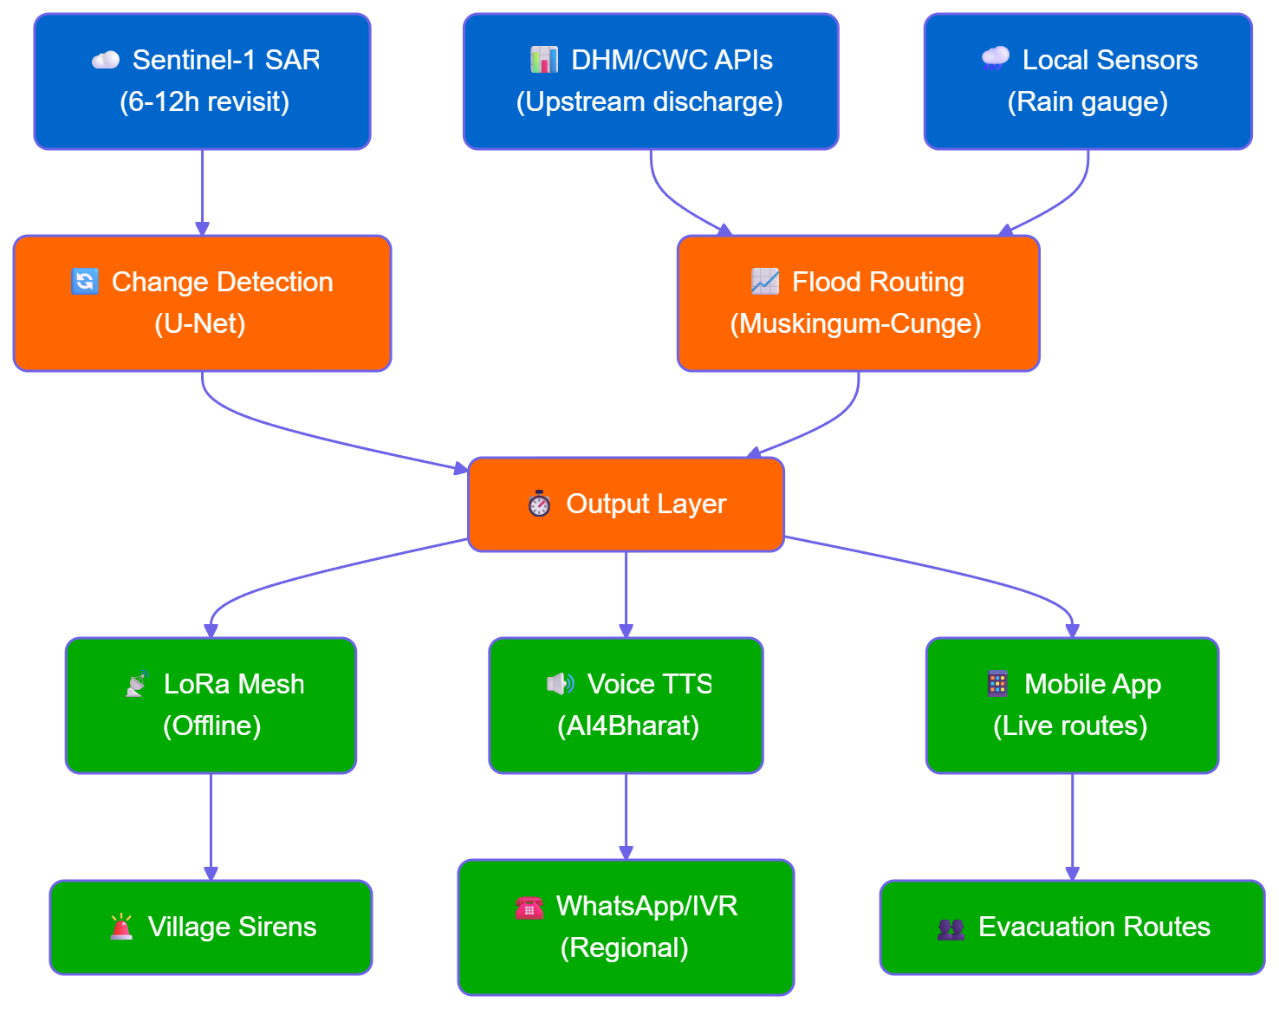
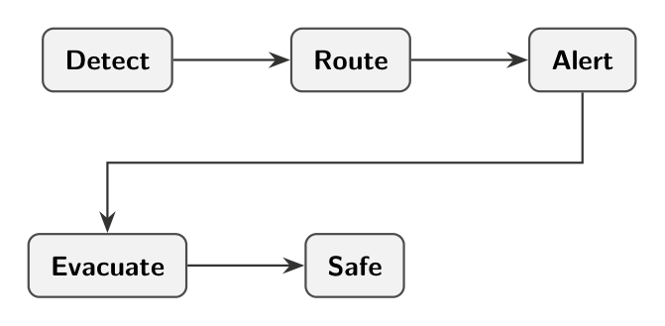
TECHNICAL APPROACH
<helloSIH>
Technologies used:
Data: Python (rasterio, gdal), GEE API
ML: PyTorch, TensorFlow, LSTM, U-Net
Backend: FastAPI, PostgreSQL + PostGIS
Frontend: React/TypeScript, Leaflet.js, Tailwind CSS
Hardware/IoT: ESP32, LoRa modules, Raspberry Pi (OpenVINO edge inference)
APIs: Copernicus Hub, DHM, CWC, Twilio/Meta (WhatsApp), Google Cloud TTS

Slide 4
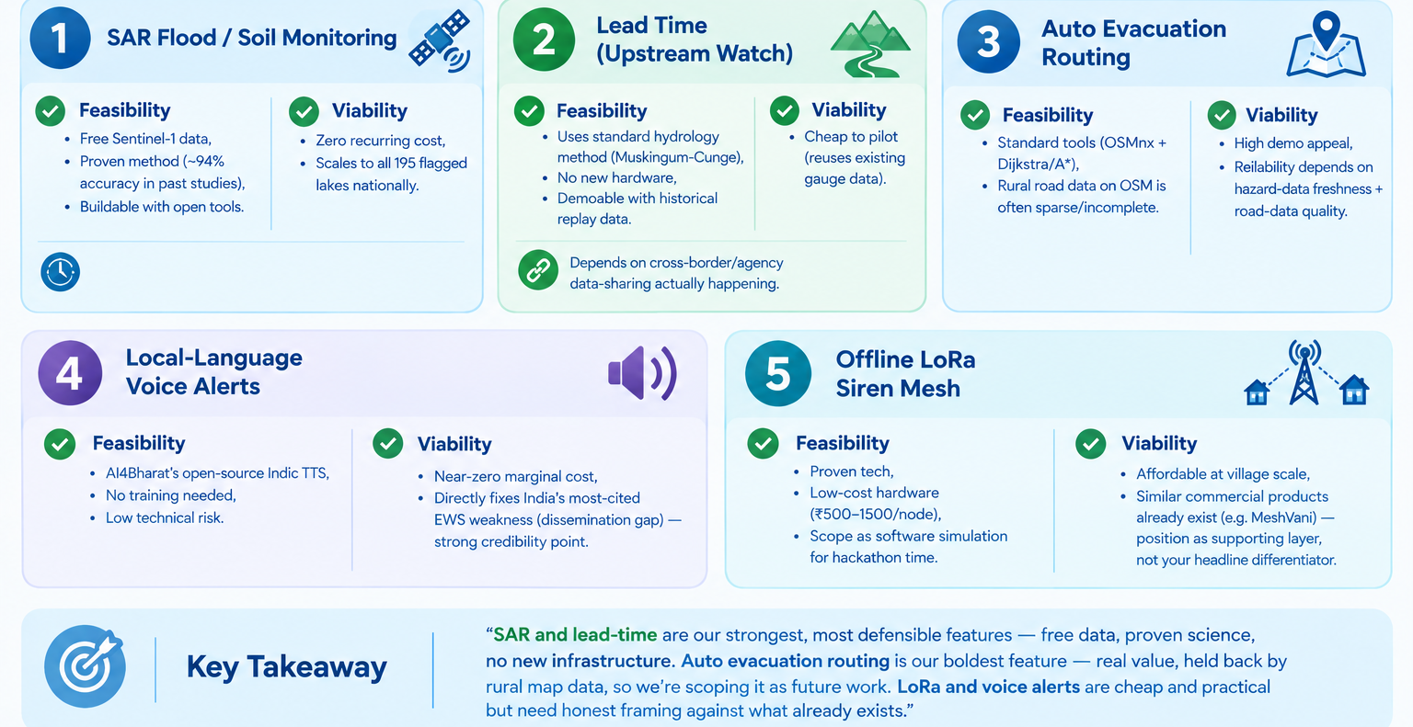
FEASIBILITY AND VIABILITY
<helloSIH>

Slide 5
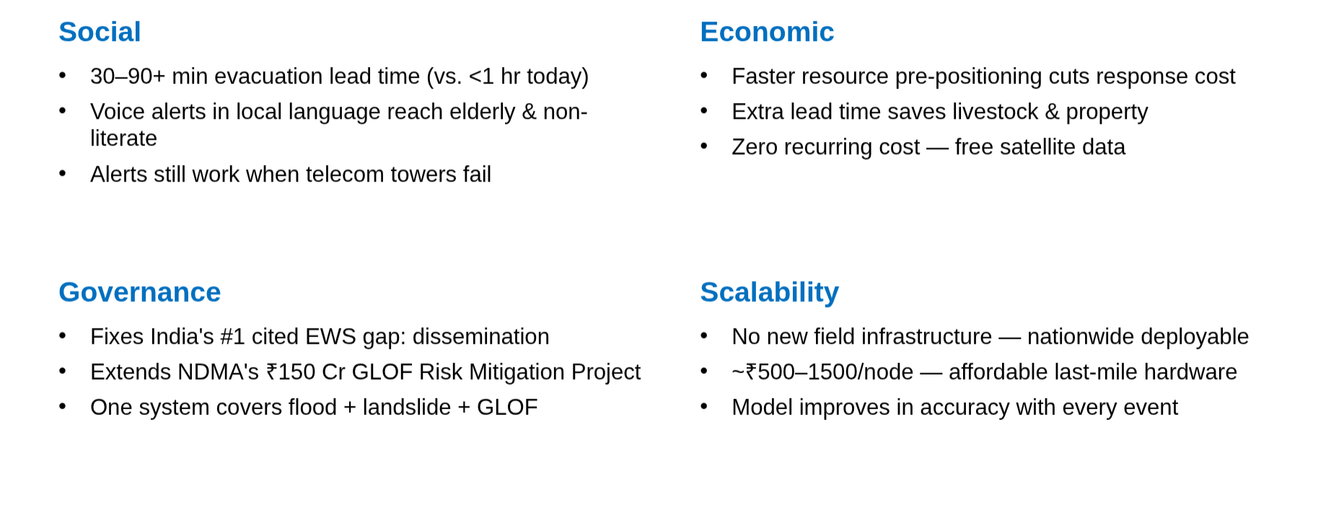
IMPACT AND BENEFITS
<helloSIH>

Slide 6
RESEARCH AND REFERENCES
<helloSIH>
1. Sentinel-1 SAR Over Optical Imagery
Arora et al. (2023): Demonstrates cloud-penetrating advantage of SAR for monsoon floods in India.
Bove et al. (2022): Benchmarks SAR vs optical, confirming optical failure under cloud cover.
2. Upstream Cross-Border Data Ingestion
Kafle et al. (2020): Covers transboundary flood early warning systems and Nepal-to-India data pipeline.
UNFCCC Case Study: Details real-world EWS implementation and downstream alerts on the Indo-Nepal border.
3. Offline-First LoRa Mesh + Edge Alerting
Tanweer et al. (2023): Implements Edge AI (LSTM on Raspberry Pi) over LoRa, optimized with OpenVINO.
Macaraeg et al. (2024): Evaluates LoRa mesh (Meshtastic) performance and range for disaster deployment.

